Slide 1

Objectives
In this session, you will learn about:
  Exception handling in JavaScript

Slide 2
Exception Handling in JavaScript
A code may contain bugs or errors, which may cause your program to generate erroneous/undesired results (or no results at all).
The errors in JavaScript can be of the following two types:
  Syntax errors: Are detected by the Web browser when the page is loaded in the Web browser.
  Runtime errors: Are detected by the Web browser at the time of program execution.
JavaScript provides various methods to handle errors including the following methods:
  try...catch block
  onerror event handler

Slide 3
Exception Handling in JavaScript (Contd.)
You can handle errors that occur during script execution by enclosing your JavaScript code within a try…catch block.
A try…catch block enables you to catch runtime errors that may occur in a page.
When an error occurs during script execution, JavaScript generates an instance of the error object.
The instance of the error object contains information related to the error that occurs.
You can retrieve this information by accessing the following properties of the error object:
  Number: Specifies a 16-bit number that needs to be operated with 0xFFFF by using the binary operator, & to produce an error code.
  Description: Provides a description of the error.

Slide 4
Exception Handling in JavaScript (Contd.)
The following table lists some error messages with their respective error numbers and description.
Error Message | Error Number | Description
Undefined identifier | 5009 | Occurs due to an uninitialized variable. For example, when a variable is not assigned a value or a local variable is been accessed by a different function.
Function expected | 5002 | Occurs due to case mismatch in the name of the function being called. For example, when a function being called is referenced by a different name.
Expected = | 1011 | Occurs when a value is assigned using a different operator. For example, when the equality (==) operator is used in place of the assignment (=) operator.
Expected } | 1009 | Occurs due to missing parenthesis. For example, when a parenthesis may be missing somewhere in the function or multiple if statements.
Wrong number of arguments | 450 | Occurs when wrong number of arguments is passed to the function. For example, when an error will occur if a function that can accept one argument is passed two arguments in the program code.
Notes:
Show all the controls using visual studio and discuss the use of few controls.

Slide 5
Exception Handling in JavaScript (Contd.)
When the code in the try block generates an error, the same is caught by the catch block.
You can handle errors that remain untrapped in try…catch blocks by using the onerror event handler.
The onerror event handler is associated with the window object.
The following code illustrates how to define a function handleErrors() as the onerror event handler.
  <SCRIPT>
  onerror= handleErrors
  </SCRIPT>
Notes:
Show all the controls using visual studio and discuss the use of few controls.

Slide 6
Exception Handling in JavaScript (Contd.)
The following example that illustrates the use of the onerror event handler:
  <html> <head>
  <script Language=JavaScript>
  onerror=errorMsg;
  function errorMsg()
  {
  alert('An error occurred on the Page!');
  }
  </script>
  The preceding code displays a customized error message to the user. In addition to the customized error message a standard error message is also displayed.
Notes:
Show all the controls using visual studio and discuss the use of few controls.

Slide 7
Exception Handling in JavaScript (Contd.)
You can suppress the standard message by making the errorMsg() function return the boolean value, true.
In the function that acts as the onerror event handler, you can display information related to the specific error that has occurred.
Notes:
Show all the controls using visual studio and discuss the use of few controls.

Slide 8
Best Practices
You can improve the performance of JavaScript code by avoiding too much use of document.write() method. This method is used for writing HTML content dynamically to the document in a window or frame. Instead, you can concatenate the data to be displayed and then write it using a single statement as shown in the following code sample:
  <SCRIPT LANGUAGE="JavaScript">
  var output =”<B>”;
  output += “ Welcome</B> “;
  output += “<img src=a.gif height=40 width=40
  alt=Flower>”;
  output += “<input type=button value=click>”;
  document.write(output); </SCRIPT>
The preceding code uses a call to the document.write method to display a concatenation of various strings on a Web page.
Notes:
Show all the controls using visual studio and discuss the use of few controls.

Slide 9
Best Practices (Contd.)
Caching of objects implies storing a repeatedly accessed object inside a variable, and then using that variable in the code, instead of making repeated references to the object. You can cache the objects such as images used in the script file in order to speed up the performance of scripts. The following code illustrates how you can repeatedly access the images collection in a Web page:
  <SCRIPT language="JavaScript">
  for (i=0;i<document.images.length;i++)
  document.images[i].src="a.gif";
  </SCRIPT>
Notes:
Show all the controls using visual studio and discuss the use of few controls.

Slide 10
Best Practices (Contd.)
  The preceding code accesses the document.images collection twice during each loop, first, to check whether the number of images in the document object is less than the value of i in the i<document.images.length statement, and then, to change the source of the images in the document.images[i].src statement. If there are 10 images on the Web page, the given code will call the images object 20 times.
  The following code illustrates how the images object can be cached by using a variable:
  <SCRIPT language="JavaScript">
  var myimages=document.images
  for (i=0;i<myimages.length;i++)
  myimages[i].src="a.gif“;
  </SCRIPT>
Notes:
Show all the controls using visual studio and discuss the use of few controls.

Slide 11
Best Practices (Contd.)
  In the preceding code, instead of making repeated references to the images object, references are made to the variable, myimages. This saves the visitors from waiting for all the images to be downloaded from the Web server. Because of the restricted number of references to the images object, not only the performance of the Web page is enhanced but the bandwidth of the users is also saved.
Notes:
Show all the controls using visual studio and discuss the use of few controls.

Slide 12
Tips and Tricks
Use backslash (\) to display special characters as literals. When a backslash is encountered at the time of processing a page, the Web browser interprets the next character as simple text instead of a special character. For example, consider the string, “The \n is used to move to the new line”. In this string, \n holds a special meaning and when a browser encounters this character, it inserts a new line instead of displaying the character on the screen. Therefore, you will have to include a \ character in the string and write the string as “The \\n is used to move to the new line”. Inserting \ before \n directs the browser to ignore the special meaning and display the special character as normal text. The following example illustrates how to display special characters as literals:
  alert ("The \n is used to move to the new line")
Notes:
Show all the controls using visual studio and discuss the use of few controls.

Slide 13
Tips and Tricks (Contd.)
  Some other character that can be displayed by preceding them with a \ character are listed in the following table.
Special Character | Symbol
single quote | ‘
double quote | “
ampersand | &
backslash | \
new line character | \n
carriage return | \r
tab | \t
backspace | \b
Notes:
FAQ Explain the HTTP is state less protocol it does not store any reference of previous request even with the same user. Server has to maintain such information pragmatically.
Explain how round trip processing maintain this state.

Slide 14
Tips and Tricks (Contd.)
Use the appname and appversion properties of the navigator object in your Web page to detect the visitors’ browser type and version and to inform them whether the content on their Web site can be rendered on their browsers or not. The following code illustrates how to detect the browser type and version:
  <html>
  <head>
  <script type="text/javascript">
  function browserDetection()
  {
  var brwsr=navigator.appName;
  var brwsr_ver=navigator.appVersion;
  brwsr_ver=parseFloat(brwsr_ver);
Notes:
Explain with example of ListBox and DropDownList control given SG in Auto Postback
Discuss when we set EnableViewState Property to true
Explain the difference between postback on self page and postback on crosspage

Slide 15
Tips and Tricks (Contd.)
  if ((brwsr=="Netscape"||brwsr=="Microsoft Internet Explorer") && (brwsr_ver>=4))
  {
  alert("Your browser supports this page!");
  }
  else
  {
  alert("Page cannot be displayed. Please upgrade your browser");
  }
  }
  </script>
  </head>
  <body onload="browserDetection()">
  </body> </html>
Notes:
Explain with example of ListBox and DropDownList control given SG in Auto Postback
Discuss when we set EnableViewState Property to true
Explain the difference between postback on self page and postback on crosspage

Slide 16
FAQs
Does JavaScript support passing an array to a function?
  Yes, JavaScript supports passing an array to a function. All arguments passed to the function can be retrieved by using the functionName.arguments collection. It is not necessary to explicitly specify the argument list in the function declaration. All the arguments passed with the function call are automatically stored in the arguments collection. The following example illustrates how to pass arrays to a function:
    <HTML>
    <HEAD>
    <SCRIPT LANGUAGE=JAVASCRIPT>
    function myfunction()
    {
    var i;
    for(i=0;i<myfunction.arguments.length;i++)

Slide 17
FAQs (Contd.)
  { document.write(myfunction.arguments[i]); }
  }
  var arr = new Array(3)
  arr[0] = "a“
  arr[1] = "b“
  arr[2] = "c“
  myfunction(arr);
  </SCRIPT>
  </HEAD>
  <BODY></BODY></HTML>
  In the preceding example, the array variable need not be explicitly specified in the argument list of the function.
Notes:
Explain with example of ListBox and DropDownList control given SG in Auto Postback
Discuss when we set EnableViewState Property to true
Explain the difference between postback on self page and postback on crosspage

Slide 18
FAQs (Contd.)
Is there a way to refer to the main window in the secondary window, which is opened by using the window.open statement?
  Yes, the secondary window can refer to the main window using the opener property of the window object. The opener property provides scripts in the new window with valid references to the original window. For example, the original window may contain some variable values or functions that a new window may require. In such a situation, the new window can make use of the <windowobject>.opener or self.opener statements.
  The following code illustrates the use of the opener property:
    <HTML><HEAD>
    <TITLE> Main Window</title>
    <SCRIPT language="JavaScript“>
    var mysubwind

Slide 19
FAQs (Contd.)
    function openWindow()
    {
    if(!mysubwind || mysubwind.closed)
    {
    mysubwind=window.open("SubWindow.html","subwindow")
    }
    else
    {
    mysubwind.focus()
    }
    }
    </SCRIPT>
    </HEAD>
    <BODY>
    <FORM>

Slide 20
FAQs (Contd.)
    Select your favorite color<br>
    <INPUT type="radio" name="mycolor" value="Pink" CHECKED>Pink<BR>
    <INPUT type="radio" name="mycolor" value="blue"> Blue<BR>
    <INPUT type="radio" name="mycolor" value="Purple">Purple <BR>
    <INPUT type="button" value="Open New Window" onClick="openWindow()">
    </FORM>
    </BODY>
    </HTML>
    Save the preceding code as MainWindow.html.
  Now, write the following code in another file:
    <HTML>
    <HEAD>
    <SCRIPT Language="JavaScript">

Slide 21
FAQs (Contd.)
    function displayColor()
    {
    var cc=self.opener.document.forms[0].mycolor
    for (var i=0; i<cc.length; i++)
    {
    if (cc[i].checked)
    {
    self.document.write("Hello from Main Window")
    self.document.bgColor=cc[i].value
    }
    }
    }
    </SCRIPT>
    </HEAD>
    <BODY onLoad="displayColor()">
    </BODY> </HTML>

Slide 22
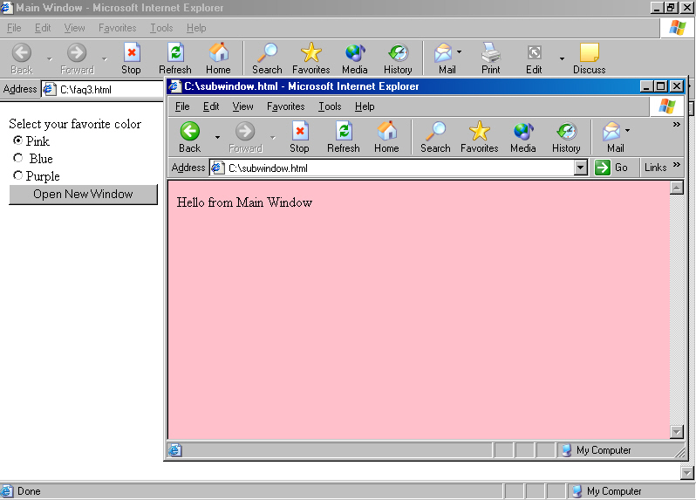
FAQs (Contd.)
  Save the preceding code as SubWindow.html.
  In the preceding code, the script in the SubWindow.html file uses the opener property to retrieve the color selected by the user on the main window. The following figure displays the output of the preceding code.

Slide 23
FAQs (Contd.)
How can I display special characters enclosed within JavaScript code, on a Web page?
  You can precede the special characters with a backslash (\) to print it on the screen. The backslash can be used before any special character if it needs to be printed on the screen and not interpreted as a special character. For example:
    <HTML>
    <HEAD>
    <SCRIPT>
    </SCRIPT></HEAD>
    <BODY>
    <script language = "JavaScript“>
    document.write ("\"Hello\"");
    </SCRIPT>
    </BODY></HTML>

Slide 24
FAQs (Contd.)
  The preceding code uses the document.write method to write “Hello” on the page. Each quotation mark, which is a special character, is preceded by a backslash. This makes the browser interpret the quotation marks as literals instead of special characters.

Slide 25
Challenge
_____________ is a JavaScript object that contains a URL and encapsulates a text or image link contained in a document.
Answer:
  link
Notes:
Show the demo by performing each step to set Web server control properties
Explain by example how to manipulate Web server control (refer SG)

Slide 26
Challenge (Contd.)
The ____________ property of the window object sets the text on the status bar of the window.
Answer:
  status
Notes:
Show the demo by performing each step to set Web server control properties
Explain by example how to manipulate Web server control (refer SG)

Slide 27
Challenge (Contd.)
__________ is a JavaScript function that returns a numeric value when given a string as argument.
Answer:
  parseint
Notes:
Show the demo by performing each step to set Web server control properties
Explain by example how to manipulate Web server control (refer SG)

Slide 28
Challenge (Contd.)
The __________ object allows you to specify URLs in a script.
Answer:
  location
Notes:
Show the demo by performing each step to set Web server control properties
Explain by example how to manipulate Web server control (refer SG)

Slide 29
Challenge (Contd.)
The ______________ property of a function allows you to retrieve all the parameters passed to a function.
Answer:
  arguments
Notes:
Show the demo by performing each step to set Web server control properties
Explain by example how to manipulate Web server control (refer SG)

Slide 30
Challenge (Contd.)
You want to check for the presence of “@” character in the value stored in the variable email_id. Which of the following methods of the String object can be used to validate the data?
  substring()
  indexOf()
  toString()
  eval()
Answer:
  indexOf()
Notes:
Show the demo by performing each step to set Web server control properties
Explain by example how to manipulate Web server control (refer SG)

